Slide 1
How business work online
By Thomas Roberts

Slide 2
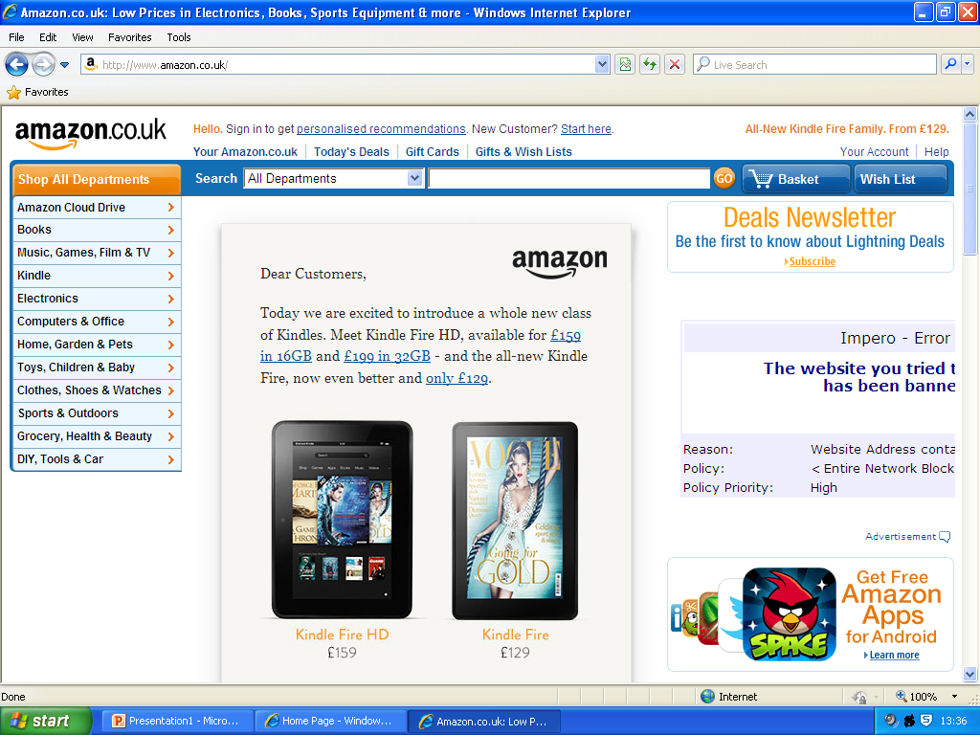
Amazon UK
It has a banner with a search bar.
Categories down the left hand side.
Great deals and on the home page.

Slide 3
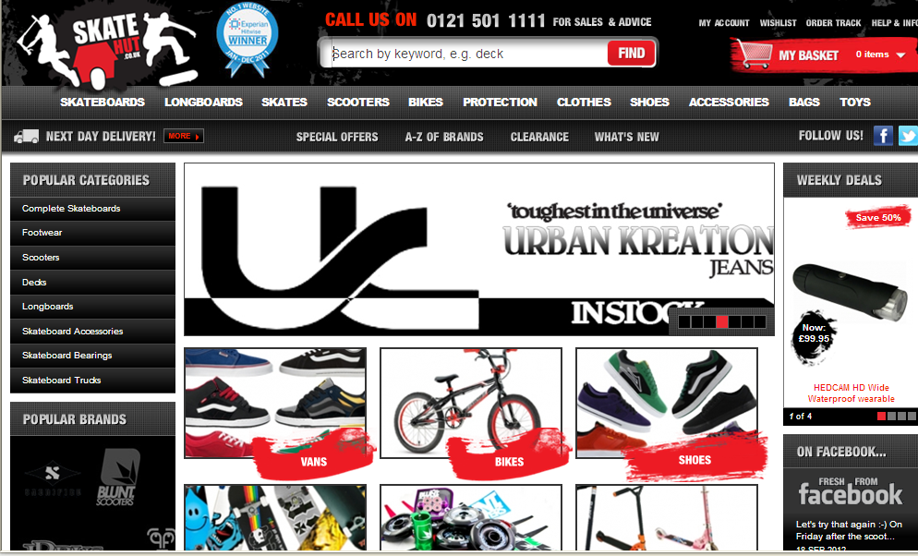
Skate hut
It has a banner with a search bar.
Categories down the left hand side and under banner.
There on Facebook and twitter.
Its got weekly deals.
Good delivery service.
Basket in top corner.

Slide 4
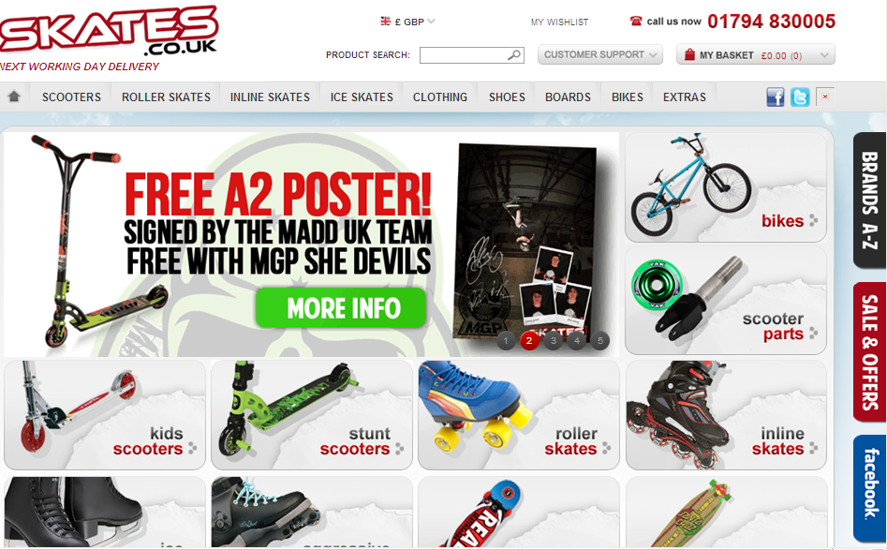
Skates.co.uk
Got a search bar.
Categories under search bar.
Free stuff.
Its with Facebook.

Slide 5
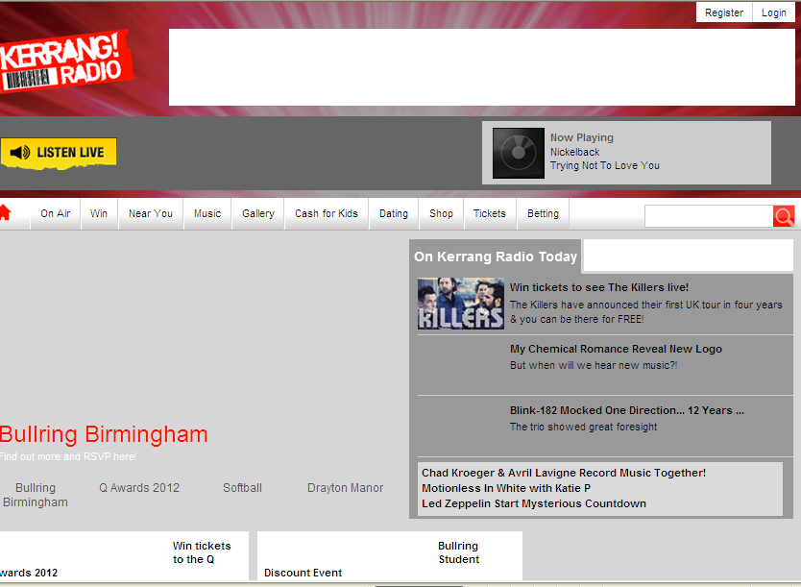
Kerrang Radio
It has a banner with a search bar.
A listen live feature.
News.
A register and login bit.

